Slide 1
Online Automatic and Robust Control Configuration Selection
Miguel Castaño Arranz Luleå University of Technology
Wolfgang Birk Luleå University of Technology

Slide 2
Outline
Introduction to Control Configuration Selection.
Description of Research results.
Concluding remarks.

Slide 3
Introduction to Control Configuration Selection

Slide 4
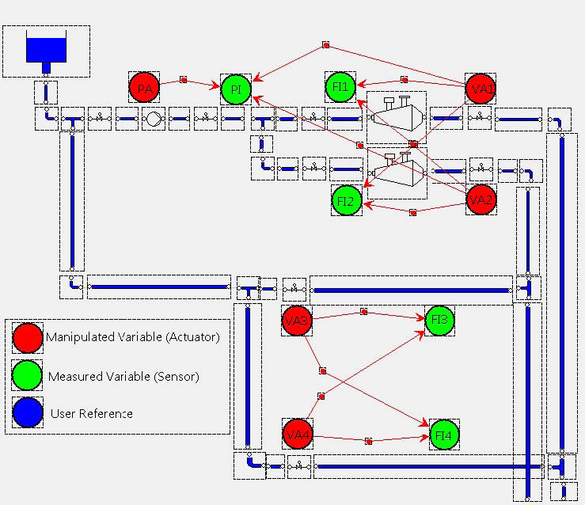
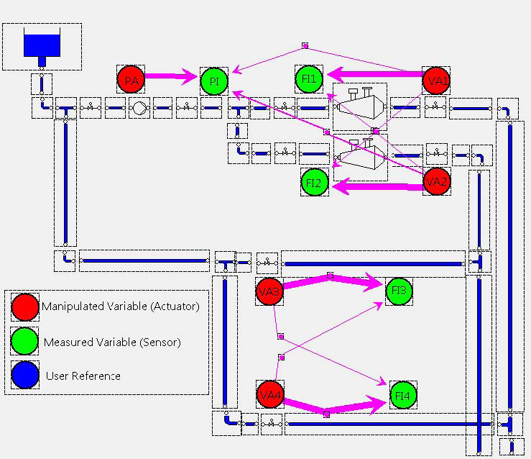
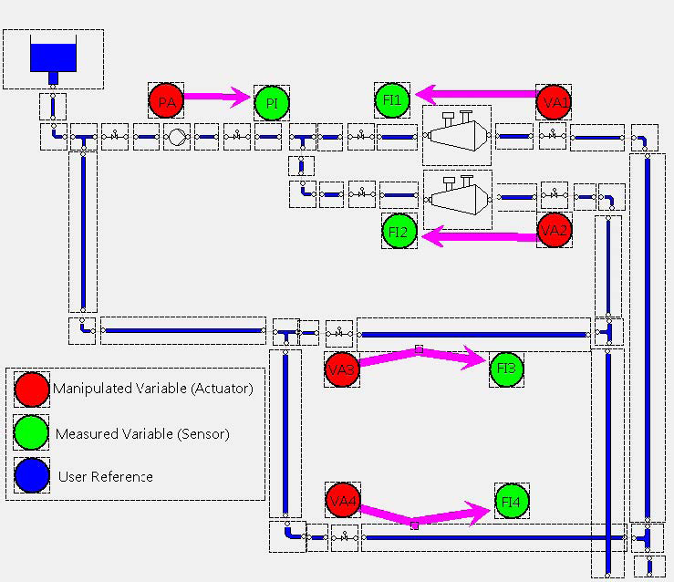
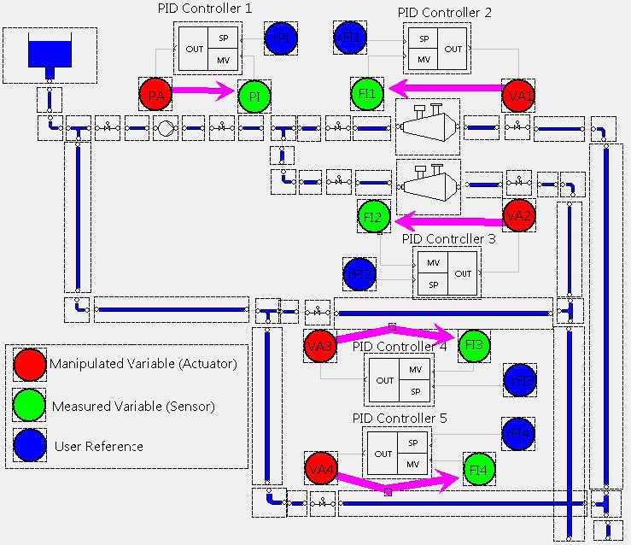
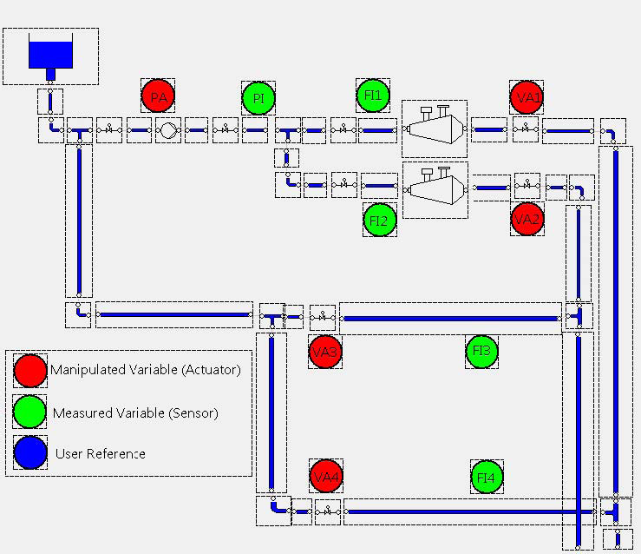






A procedure for control design of complex processes
Subset of sensors and actuators
(IO Selection)
Model
Control Configuration
Performance specification
Controller parameters
Implemented controller
Example: Stock Preparation Plant at SCA Obbola AB, Sweden

Slide 5
Control Configuration Selection
Problem definition:
Determine a control configuration of least complexity that yields a sufficient closed-loop performance for the complete multivariable system, without designing the controller parameters.
The control configuration complexity is quantified as the number of non-zero elements in the transfer function of the controller.
Why not designing a full MIMO controller?
Full multivariable controllers have the largest achievable performance. However:
Decentralized controllers are simpler to design, implement and maintain.
Decentralized controllers are more robust to plant failures.
There is a trade-off between simplicity and robustness Vs achievable performance.

Slide 6
Design of Sparse Control Configurations
Solution Using Interaction Measures: Determine the most significant input/output channels G_{ij} in a multivariable transfer function G(s) and select them for the controller design.
Methods based on gramians can be used to quantify the significance of interconnections.
Low Complexity (Decentralized) Controller
Plant
r
+
e
u
y
-

Slide 7

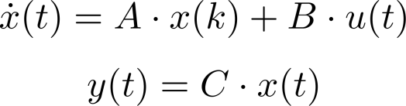

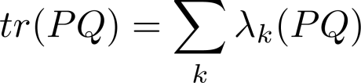
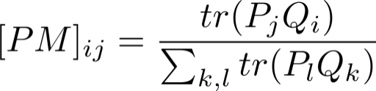
Participation Matrix: Quantification of system dynamics using gramians
P and Q are the controllability and observability gramians.
The eigenvalues of the product PQ quantifies the connection of the input and output spaces through the state space.
The sum of the eigenvalues (trace) of PQ can be used to quantify system dynamics.
Those channels G_{ij} with largest value of tr(PjQi) are the most important interconnections.
tr(PQ) is the indicator used by the interaction measrure named Participation Matrix.
(A. Conley & M.Salgado, CDC 2000).

Slide 8
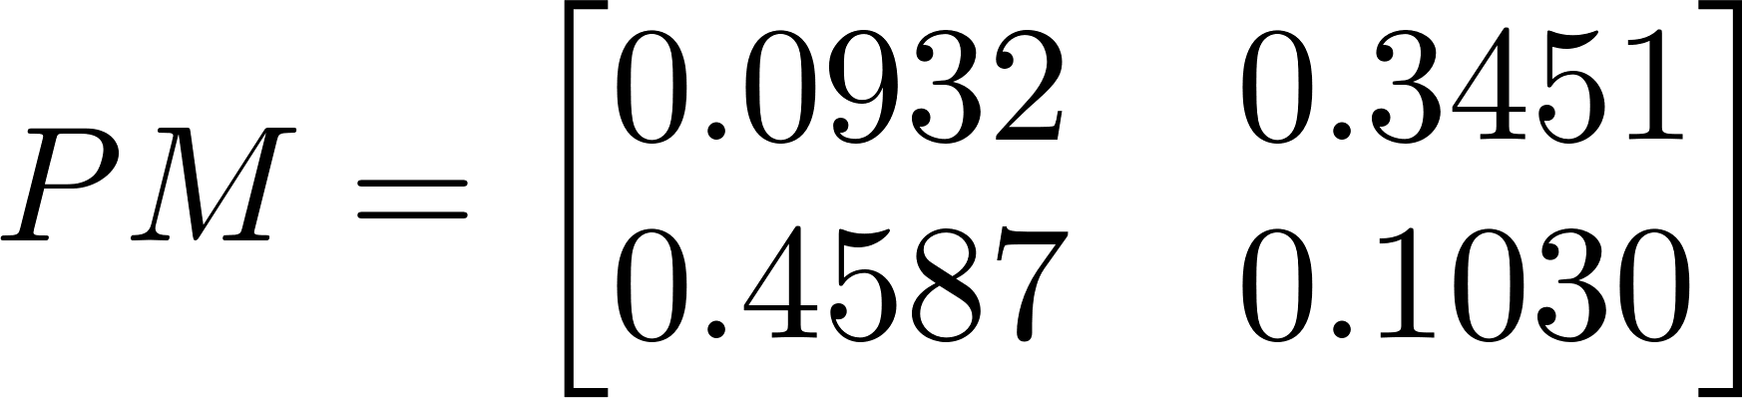
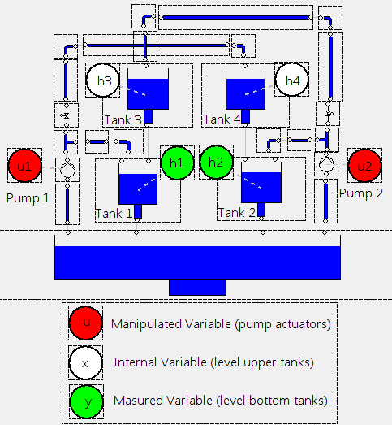
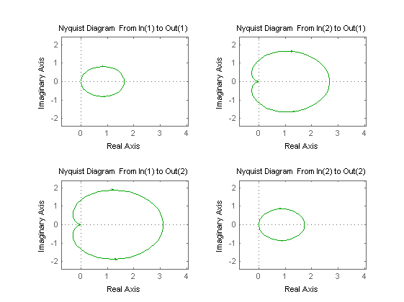
Participation Matrix example on a 2x2 process
The sum of all the elements in PM are always 1
In this example, the off-diagonal elements add up to 0.8. This means that an off-diagonal decentralized controller would consider 80% of the process dynamics.
Configurations with a contribution larger than 0.7 are expected to derive in satisfactory performance.
The PM has a direct relationship with the Nyquist diagram. Those channels with larger area in the Nyquist diagram are the most significant.

Slide 9
Research Results

Slide 10
Introduction of an online automatic and robust Control Configuration Selection method
This paper integrates three research trends within Control Configuration Selection.
Robust Control Configuration Selection: to address model uncertainty.
Online Control Configuration Selection: to calculate Interaction Measures from process data.
Automatic Control Configuration Selection: to create algorithms which design Control Configurations using Interaction Measures as opposite to the heuristic and manual use of Interaction Measures.
We proceed now to describe each of these research trends and later describe the aggregation of all of them.

Slide 11
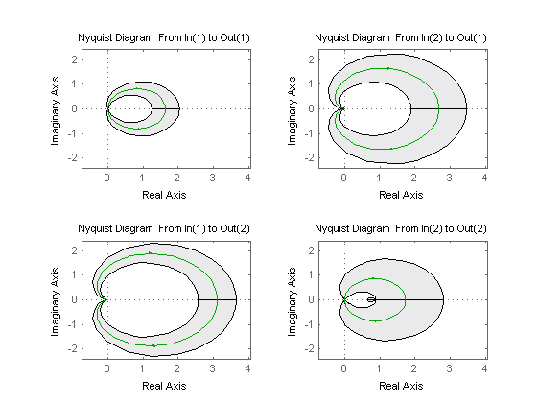
Robust Control Configuration Selection
Consider the previous example for which an off-diagonal decentralized controller was suggested.
Model uncertainty can be translated to uncertainty regions in the Nyquist diagram.
Question: Is the decision based on the nominal model still valid when uncertainty is considered?
Robust Control Configuration Selection aims at translating model uncertainty to uncertainty bounds on Interaction Measures.

Slide 12
Online Control Configuration Selection
Online Control Configuration Selection (CCS) aims at estimating Interaction Measures from process data.
Advantages of Onlince CCS:
Selecting configurations without the need of parametric models.
Posterior modeling efforts need to be placed only I/O chanels which were found to be significant.
Example:
Consider a process size 6x6. If we apply traditional CCS, then we need to create 6x6=36 SISO models. If a decentralized controller is later used, only 6 of those SISO models will actually be used for control design and 30 models would be discarded leading to superfluous work.
If on the contrary we use Online CCS, then we can determine from an experiment which I/O channels we will use for control and focus on modeling only those.

Slide 13
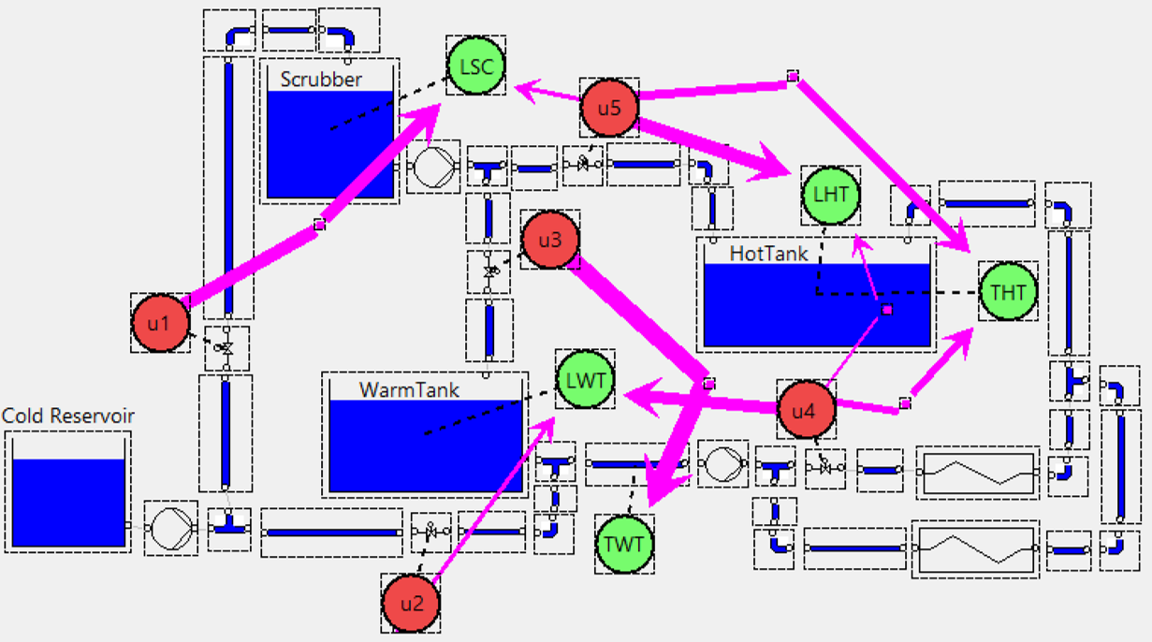
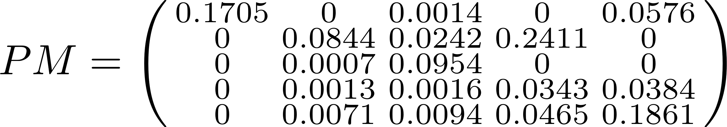
Automatic Control Configuration Selection
There are difficulties when using Interaction Measures to manually choose control configurations.
For the example below, you will find it difficult to pick the minimum number of IO channels with a contribution larger than 0.7, choosing at least one element per row and column.
Automatic CCS aims at formulating optimization schemes for the selection of control configurations using Interaction Measures.
u1 u2 u3 u4 u5
LSC
LWT
TWT
THT
LHT

Slide 14
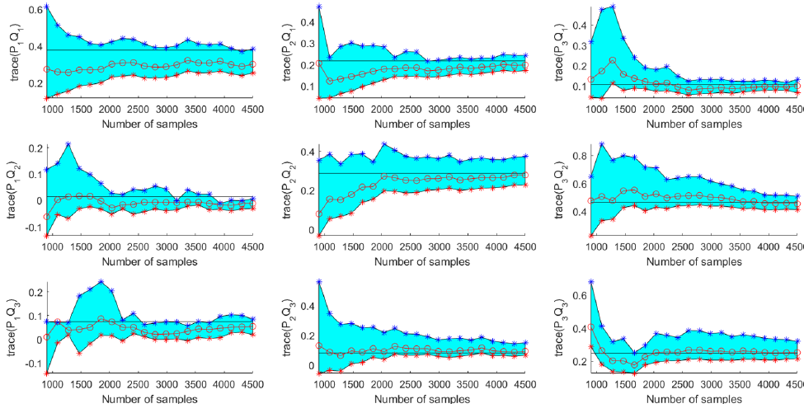
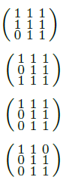
Aggregation of techniques to create an Online Automatic and Robust Control Configuration Selection Method
The introduced method estimates the Participation Matrix from process data and automatically selects a robust configuration considering the uncertainty bounds on the estimation.
For small number of samples, uncertainty is too large and there is not enough evidence to discard many I/O channels. A robust configuration is in this case complex.
As the number of samplesincreases, the configuration is simplified.
The algorithm recognizes when sufficient data has been acquired and the simples configuration is found.
Estimation of PM: tr(P_{j}Q_{i})
Number of samples
Control Configuration (Binary matrix with the Important channels)
900
1468
2226
2416

Slide 15
Concluding remarks
Methods for robust estimation of Interaction Measures allow to take decisions in the control structure selection without the need of creating parametric models.
If parametric models are needed, the modeling effort should be focused only in those I/O channels which were found to be significant. Therefore, modeling effort is saved.

